Slide 1
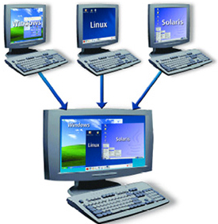
LINUX – SYSTEM ADMINISTRATION
Docente: Dott. Daniele Gobbo Modulo 3

Slide 2
Task Automation and Scheduling Using Cron (crontab)
Cron is is one of the most useful utilities when it comes to Linux administration.
It allows you to schedule commands or tasks also known as cron jobs at a specific time.
Cron runs as a daemon and is used to automate repetitive tasks like backups, monitoring disk space usage, updating the system with the latest application versions, sending e-mails, rotating logs and so on.
The word crontab has three different meanings:
1- is the text file that contains the user's cron jobs
2- is the command called crontab used to manage the crontab files
3- is the configuration file for the system wide cron jobs
LET CHECK IT !!!!

Slide 3
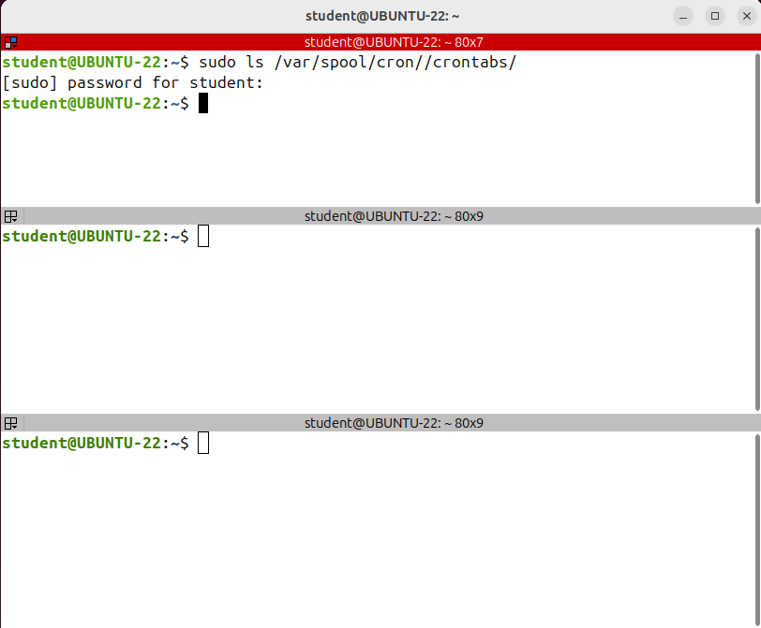
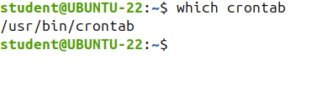
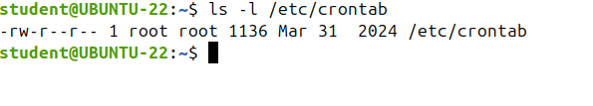
Task Automation and Scheduling Using Cron (crontab)
There is such a file for each user and on Ubuntu the files are located in /var/spool/cron/crontabs.
This is the command
This is is a configuration file for the system wide cron jobs

Slide 4
Task Automation and Scheduling Using Cron (crontab)
There are two types of cronjobs:
1- system-wide
2- individual user cron jobs.
Let's take them one by one and start with the individual cron jobs.
Each user has a crontab file, which is short for cron table, where all scheduled cron jobs of that user are specified.
These files are located in a subdirectory of /var/spool/cron/
The exact location can depend on the Linux distribution
You can edit the cron tabfiles by hand using a text editor, even though they are not intended to be edited directly.
It's recommended to use the cron tab command instead.
This will open the file using your preferred or default text editor and validate the file's structure on exit.

Slide 5
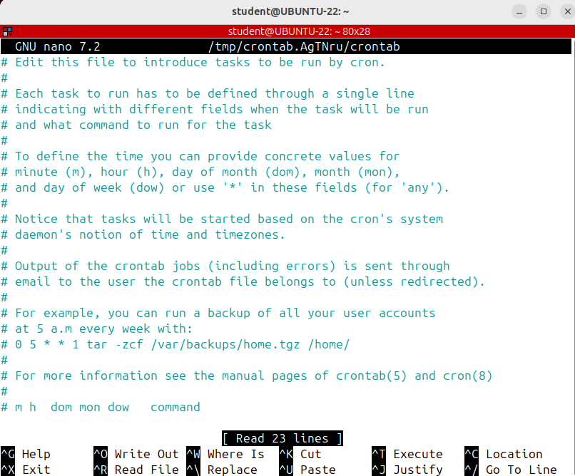
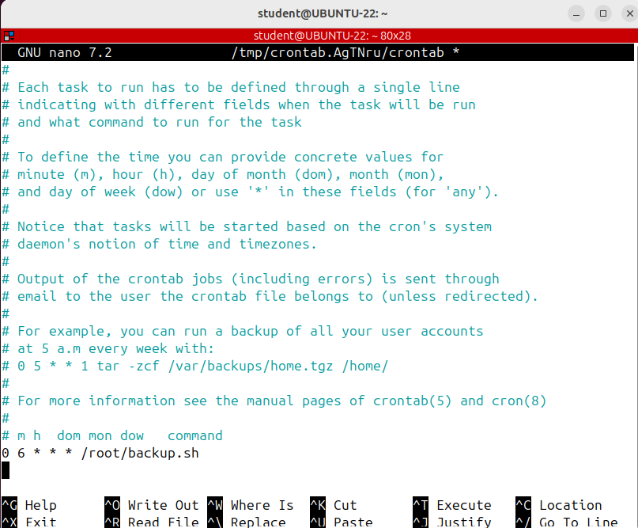
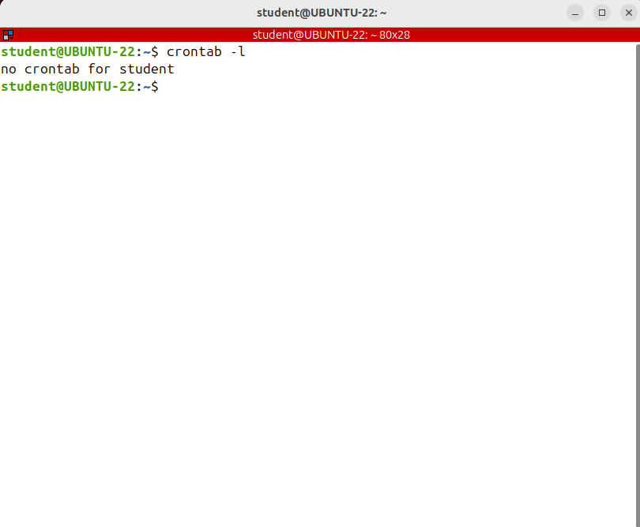
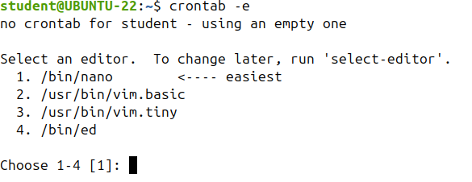
Task Automation and Scheduling Using Cron (crontab)
The first field indicates the minute.
The second of the hour.
Then day of the month.
The month.
The day of the week
finally the command.
An asterisk in the day or the week field means every day or every week.
Note that the minimum time unit used by cron is the minute.
If you want to schedule a task to run every 15 seconds, then you cannot use cron.
To display the contents of the crontab file of the current user run crontab -l.
ATTENTION: the hour is given in 24 hour time format, so between zero and 23; do not
use p.m. or a.m. If you want to run the command at four p.m., you write 16 in the hour filled.
The day of the week, which is the last time field that specifies the time can be between zero and seven, where 0 = 7 = Sunday.
Note that the lines that start with a hash sign are comments; each task to run has to be defined through a single line that consists of 6 fields separated by a white space.
The first 5 fields define when the task will be run and the last field represents the command or the script to run
To edit the current user’s crontab file run: crontab -e
-e comes from edit. You will be prompted with some editors to choose from if there is no default editor set. I'm choosing nano.
we want to run a backup script every day at six a.m. So the minute zero, the hour six a.m. and three *
The script backup1.sh will run on Sundays at 6 a.m.
This run a script that monitors the free disk space every minute.
The script will run on weekdays between 9 and 5 p.m. once per hour during working days
want to run the task at 4, 6 and 10 a.m.

Slide 6
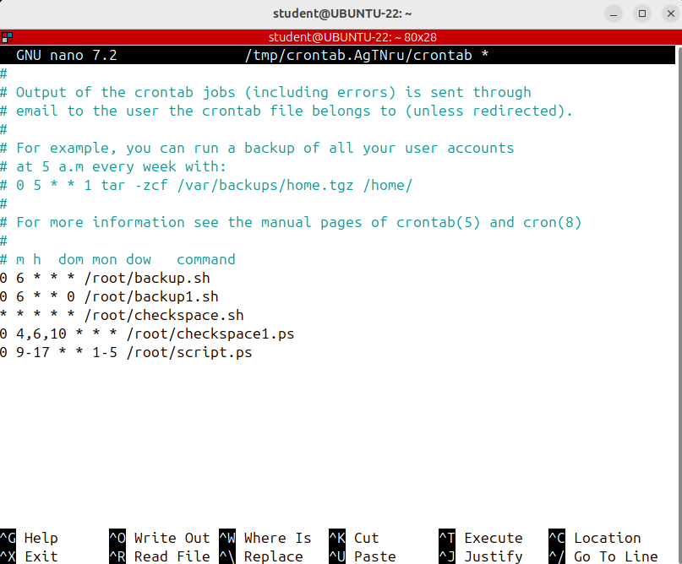
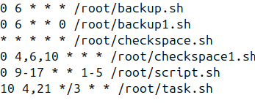
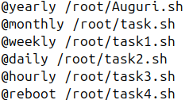
Task Automation and Scheduling Using Cron (crontab)
the task will be run every 3 days at 4 and 21 at
minute 10.

Slide 7
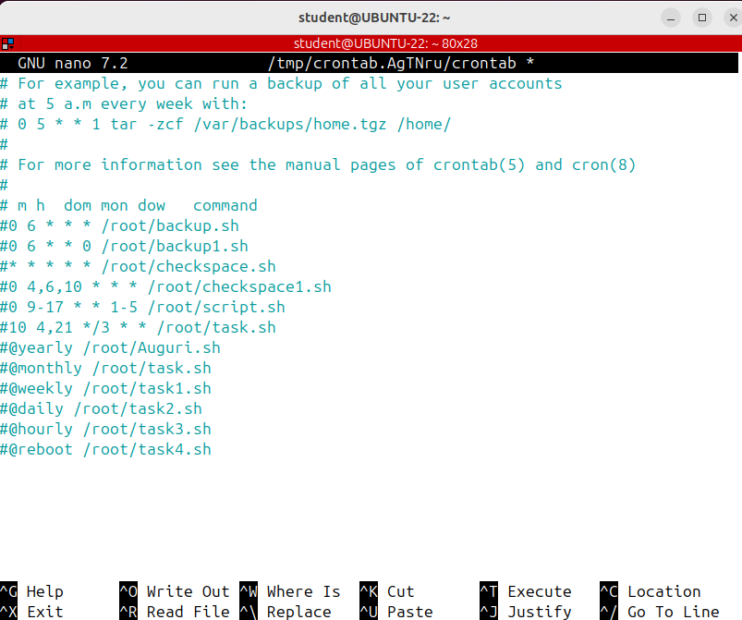
Task Automation and Scheduling Using Cron (crontab)
PRATICAL EXAMPLE:
I want to append the current date and time to file every 2 minutes.
SAVE AND EXIT

Slide 8
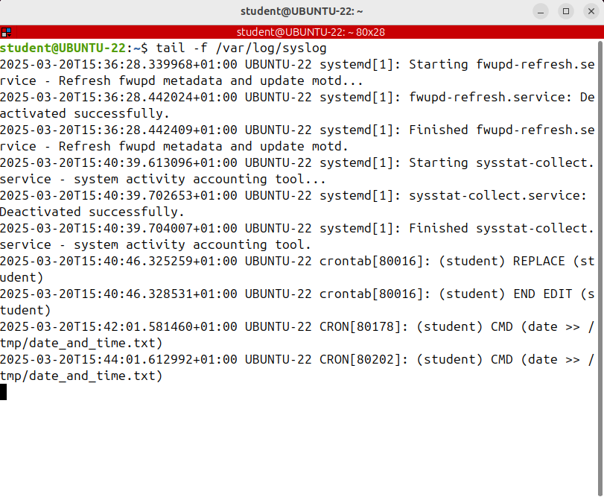
Task Automation and Scheduling Using Cron (crontab)
to see that it really works, I'll display the cron log file in real time using tail-f so
tail -f /var/log/syslog this is the cron log file on Ubuntu
Press CTRL+C to stop it

Slide 9
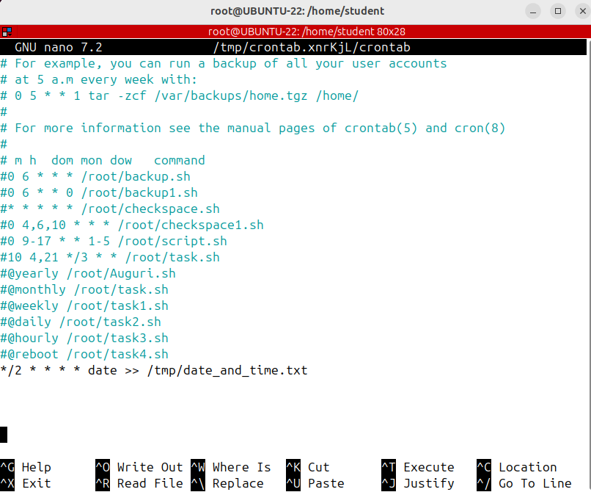
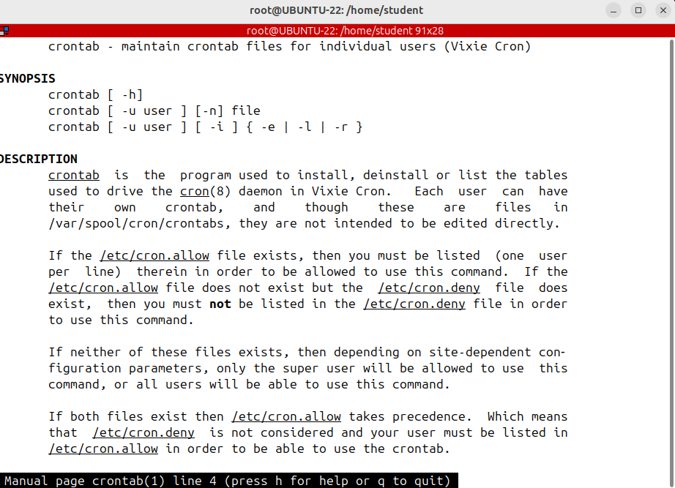
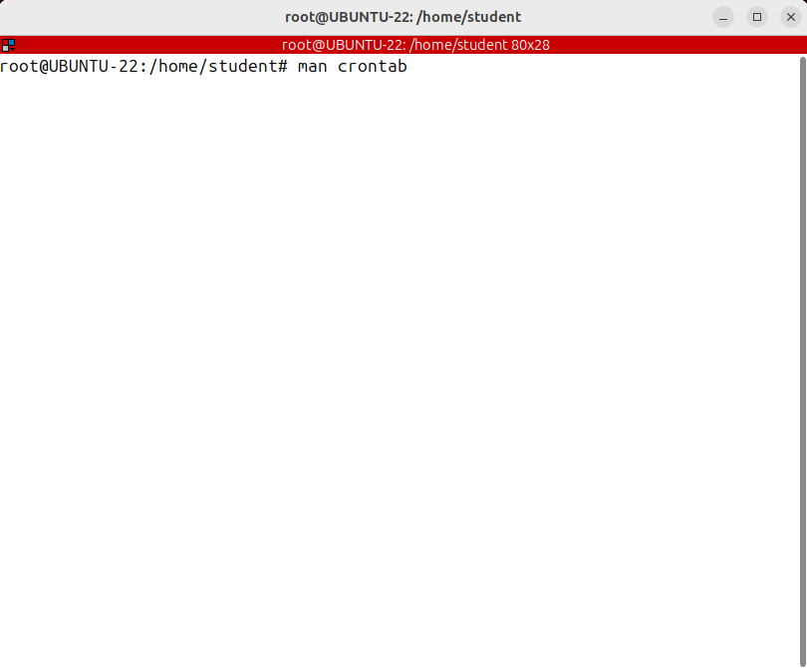
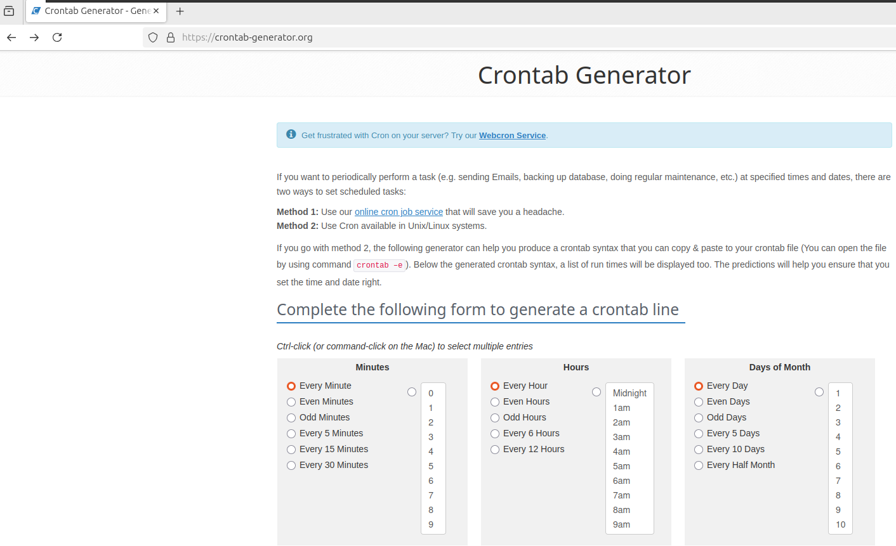
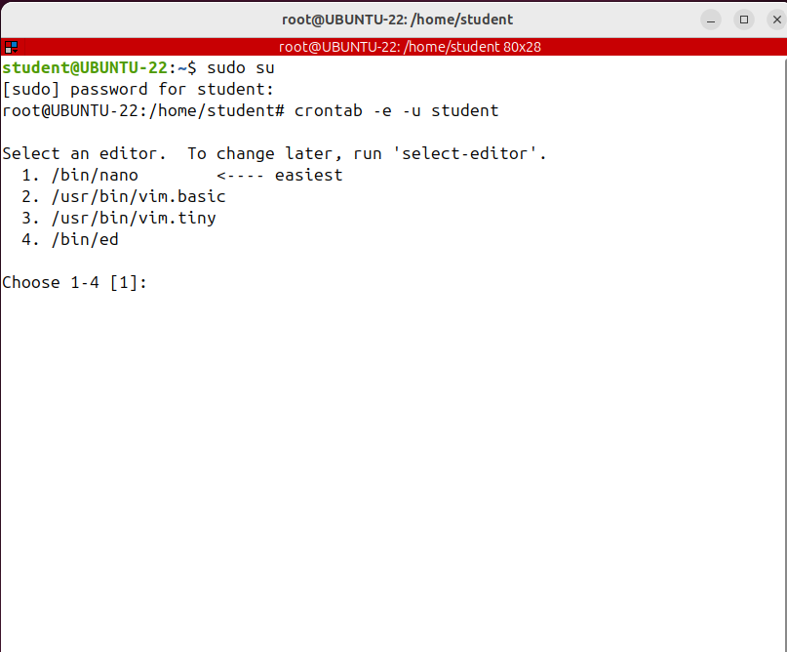
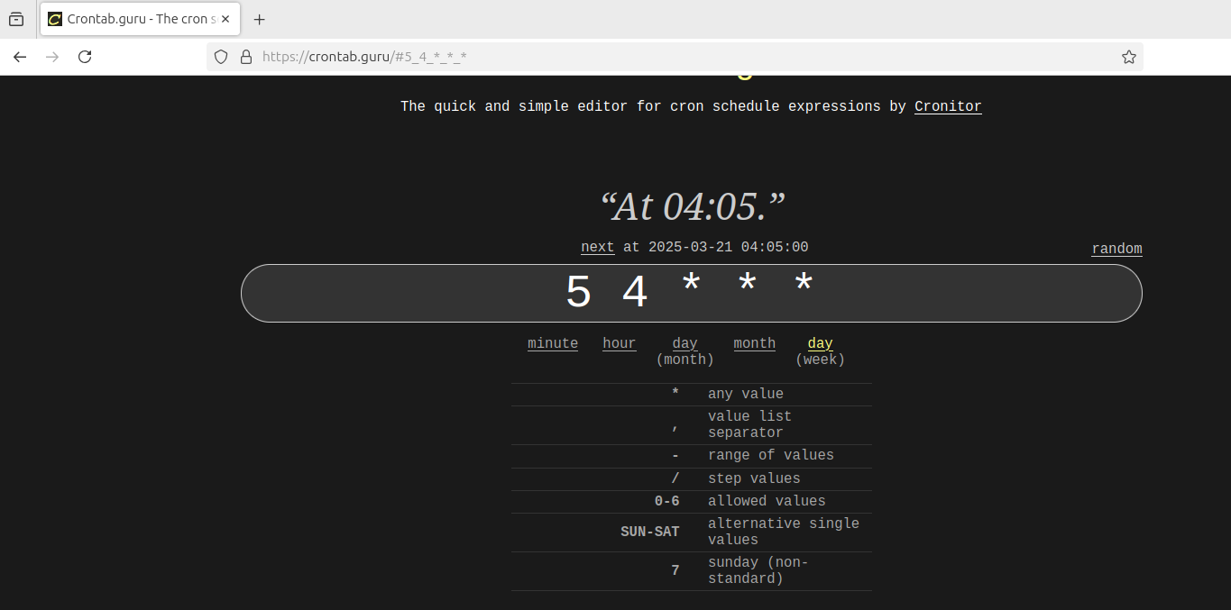
Task Automation and Scheduling Using Cron (crontab)
To remove your crontab file run: crontab -r
PLEASE NOT not removing it.
Root can also set some restrictions in regards to which users have access to their own crontab files:
there are a few web-based crontab syntax generators available to make this even easier.
Two such websites are crontab.guru and crontab-generator.org/
Note that root can edit, list or remove other users' crontAB t using the -u option and the username.

Slide 10
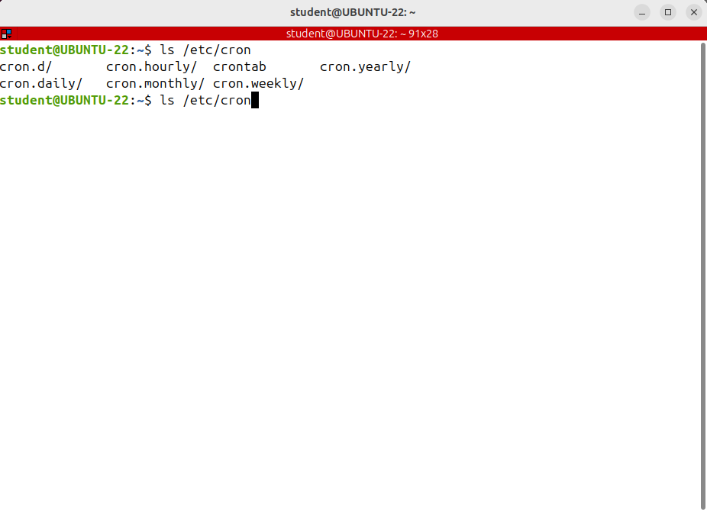
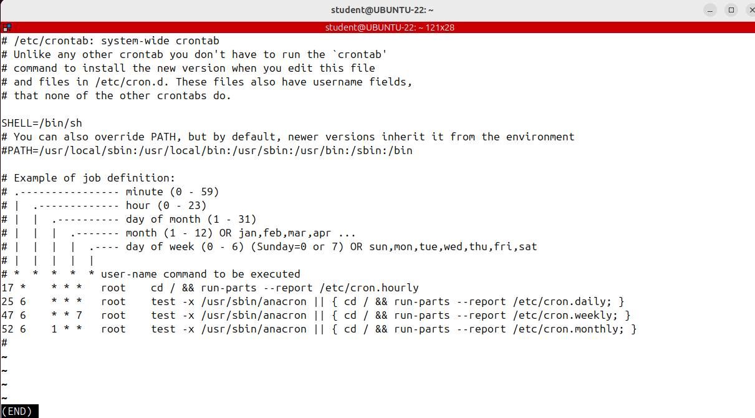

Task Automation and Scheduling Using Cron (crontab)
Press double tab
there are some system cron jobs that will be run as root.
How does it work?
You simply move your scripts inside some directories.
These are the directories /etc/cron.daily, hourly, monthly and weekly And the scripts will
be executed every hour, day, week or month.
For example, if I move my script to cron.hourly
the script will be executed hourly.
Cron jobs are intended for servers or machines that are running continuously. If the system is down, when the cron job is scheduled to run, the task is lost.
It will not be run when the machine starts.
We'll talk about anacron, which can be used to execute commands periodically, without assuming that the machine is running continuously.

Slide 11
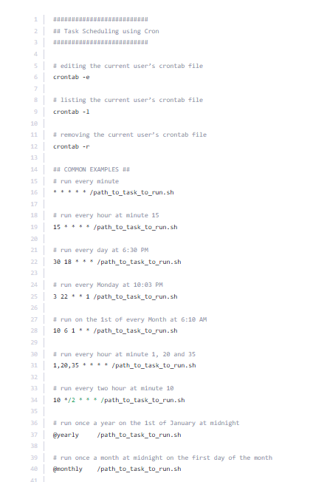
Task Automation and Scheduling Using Cron (crontab)

Slide 12
Scheduling Tasks Using Anacron (anacron)
Anacron is similar to cron, just that it’s usually used on systems that are not up all the time, such as desktops or laptops.
Anacron does not expect the system to be running 24 x 7 like a server. When you want a background job to be executed automatically on a machine that is not always up, you should use anacron instead of cron.
For example, if you have a backup script scheduled to run every day at 10:00 PM as a regular cron job and if your laptop is not up at 10 pm, your backup job will not be executed
when the system starts, it is skipped until the next schedule.
However, if you have the same job scheduled using anacron, you can be sure that it will be executed once your laptop starts.

Slide 13
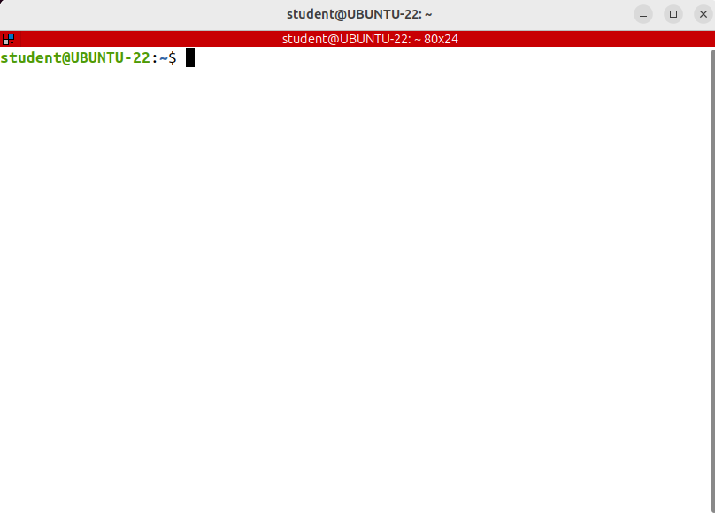
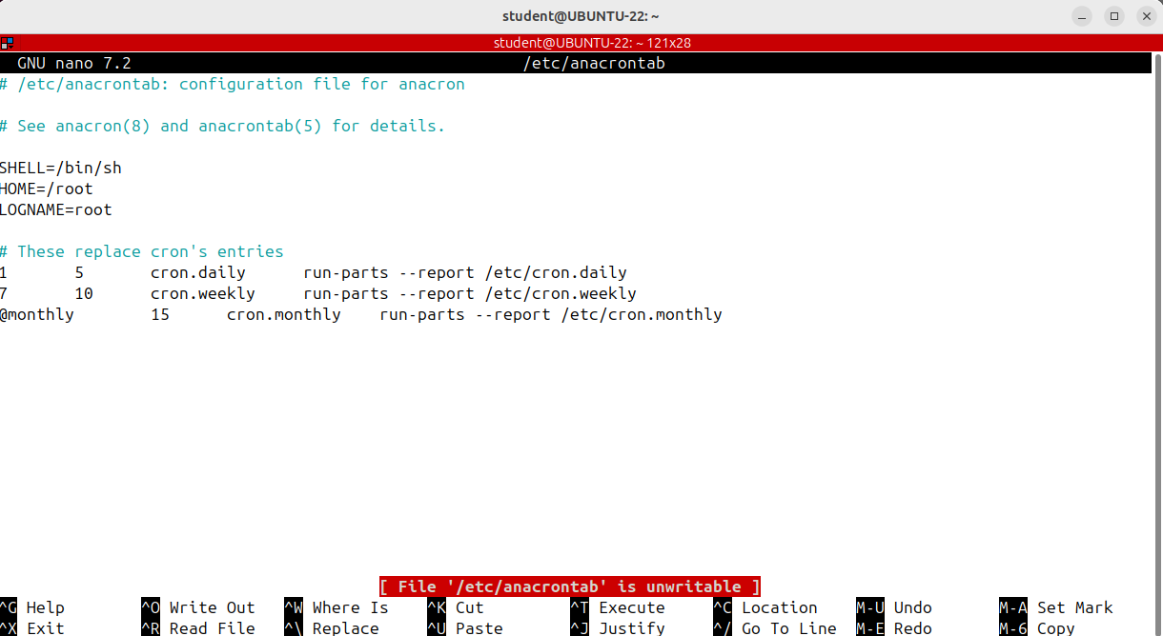
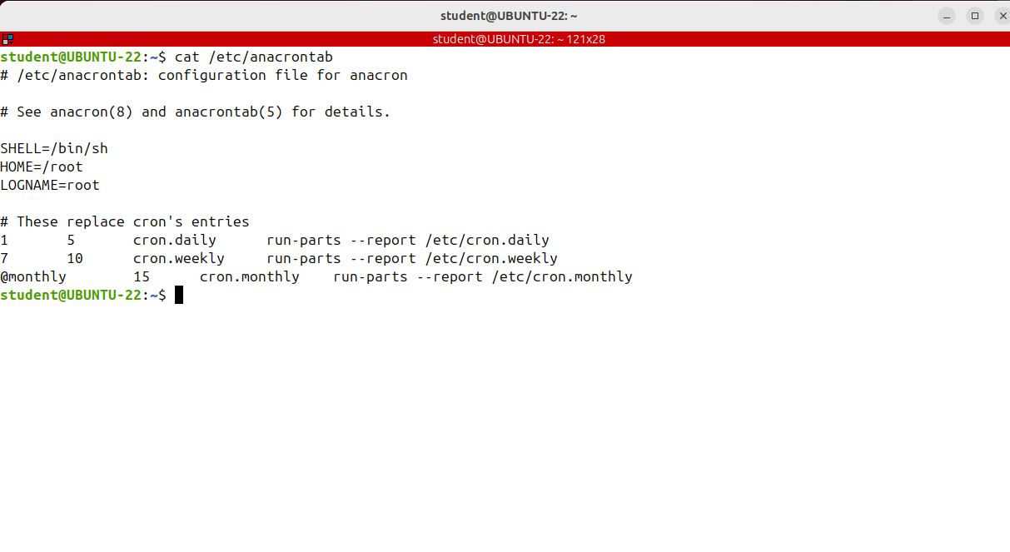
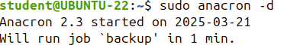
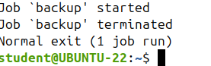
Scheduling Tasks Using Anacron (anacron)
If cron runs as a daemon, anacron is just a command that has to be run in order to execute the scheduled tasks.
In fact anacron is run automatically each time the system starts.
Also note that anacrone is run by root so the tasks will have privileges and the frequency of the job execution is expressed in days, not in minutes, like in the case of cron.
The file which specifies the anacron jobs is /etc/anacrontab.
is a command which runs all the executable files found in a directory.
Before running anacron, I can check for any syntax error by running:
Anacron -T
If there are any errors in the anacron tab file, it will print out a message indicating the error.
Normally, anacron jobs are run in the background and nothing is printed on the screen.
However, when you test it, you want it to run in the foreground so you can see its output; that's what option -d does.
It doesn't force anacron to the background.
is the delay in minutes
It specifies how long anacron will wait before executing the job.
The delay feature is intended to keep the system from being overloaded with lots of jobs if anacron determines it needs to run several commands when it starts up. It won’t run them simultaneously, but with a delay.
Period in DAYS.
In this field you can also use something like @daily, @weekly or @monthly.
For example, this line means that all executable files or scripts found in /etc/cron.weekly will be executed with a frequency of seven days.
The third field is the job identifier; it should be unique for each job, and it's the name of a file that will be created under /var/spool/anacron directory.
This is called the Job Timestamp File and will contain a single line that indicates the last time when this job was executed.
I wanted to run every two days, with a delay of one minute, so one minute after the computer starts or anacron is executed manually; the name of the job will
be backup so the script will be /root/backup.sh
However, for this example, I'll use a simple command just to check that it works.
And I'm saving the file.
And as root I'm running anacron -d

Slide 14
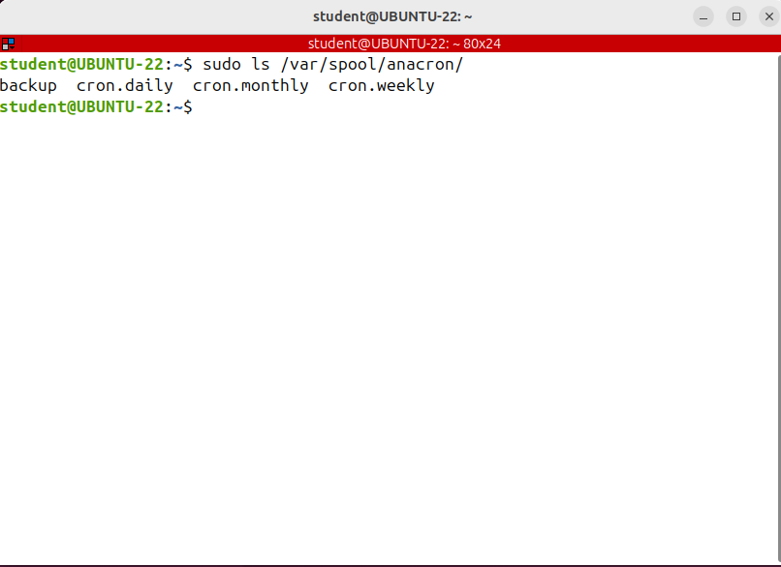
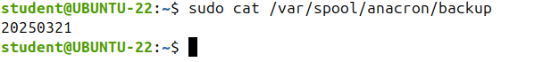
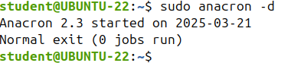
Scheduling Tasks Using Anacron (anacron)
The name of the job is back up, so the job timestamped file is called Back Up and it was created in/var/spool/anacron
If I run anacron again, it will say that it has no jobs to run.
All the jobs have already been executed!

Slide 15
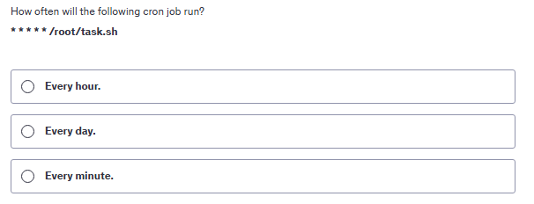
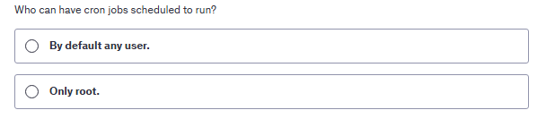
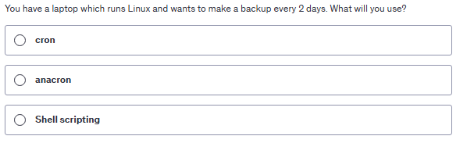
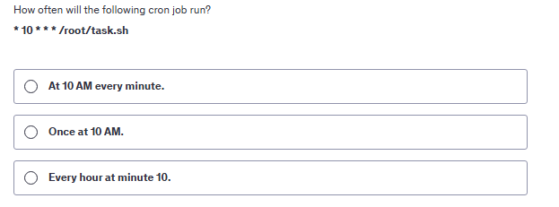
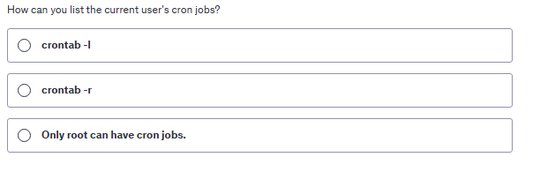
QUIZ (cron & anacron)

Slide 16
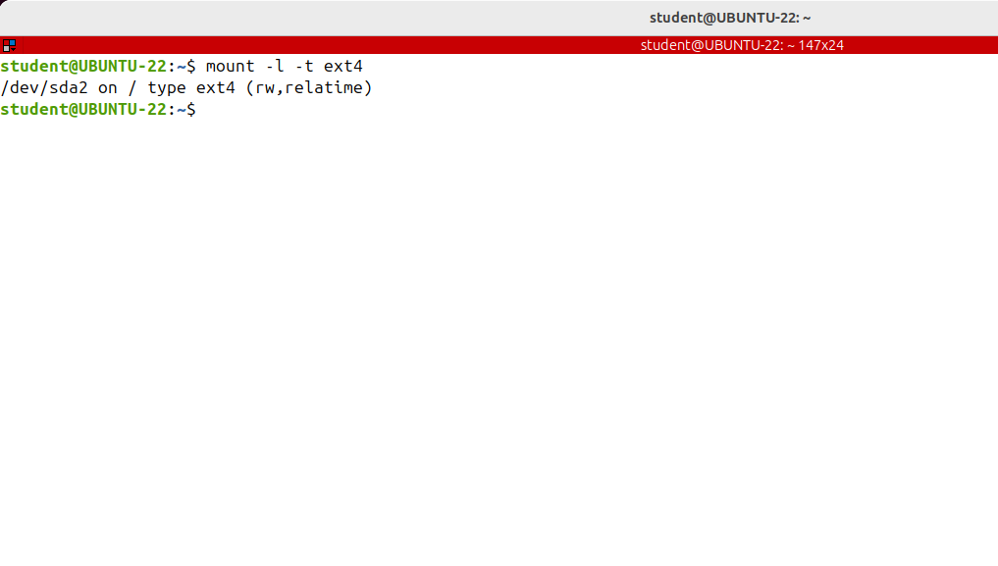
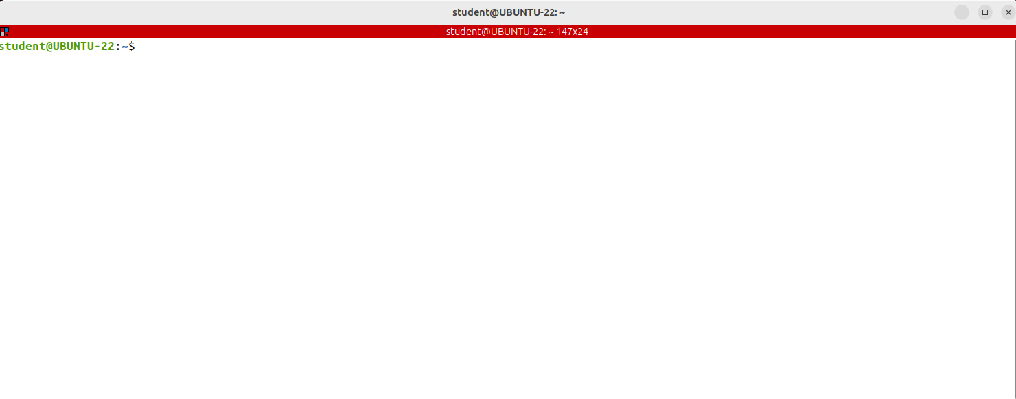
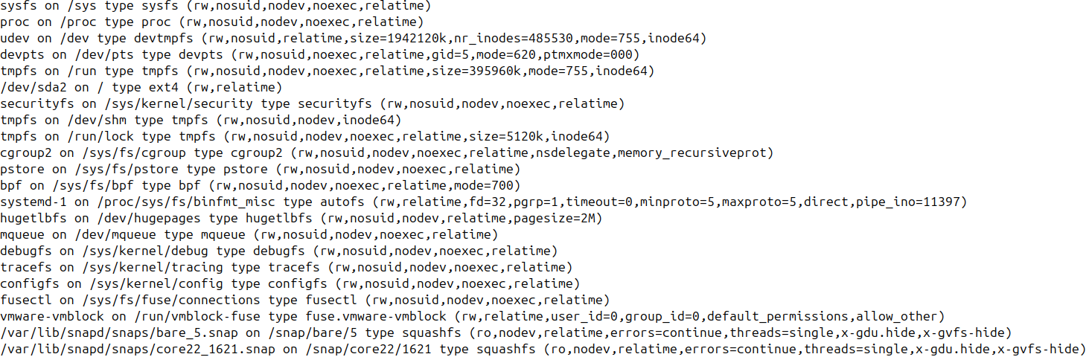
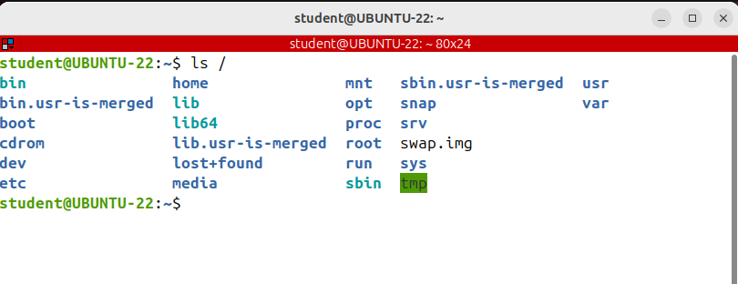
Mounting and Unmounting File Systems (df, mount, umount, fdisk, gparted)
I want to know how to mount and unmount file systems in Linux.
As you already know, on Linux, the structure of the file system is hierarchical, much like an upside down tree.
The root directory, which is forward slash, lies at the base of the file system and all other directories are spreading from there.
This is the root directory:
If you want to access a file system that's on another partition or disk, you need to mount it or logically attach it to an existing directory of the unique file system.
That directorat is called Mount Point.
To mount or to attach a file system in the directory tree, use the mount command.
If you run it without any argument, it will display all currently attached file systems.
The output is really large because it includes virtual file systems such as sysfs, tmpf, proc
so on.
We are not interested in the virtual filesystems for the moment. This is for example the partition that is mounted on the root directory
This is for example the partition
that is mounted on the root directory
To display only certain filesystem types use -t option.
For example, I want to see only ext4 files systems.
This is the default filesystem type for most modern Linux distributions

Slide 17
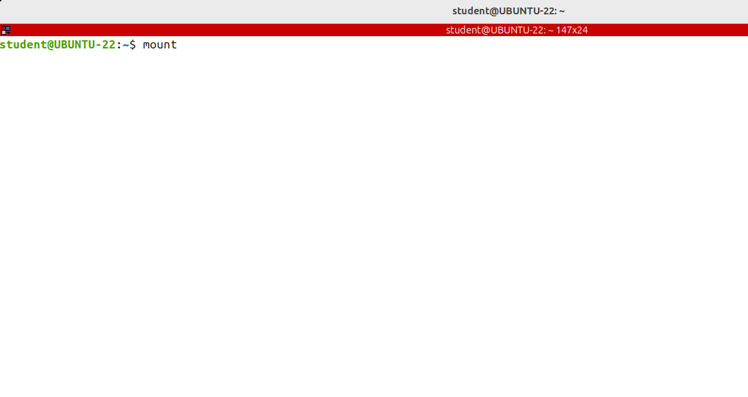
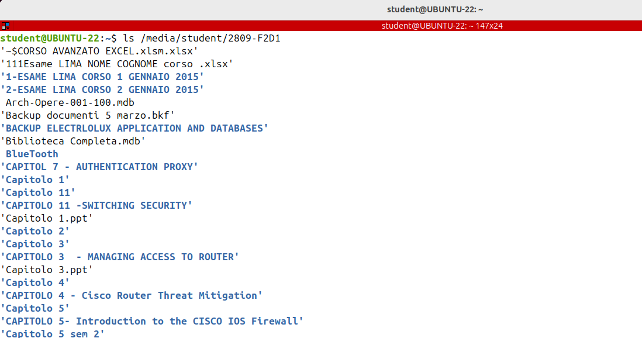
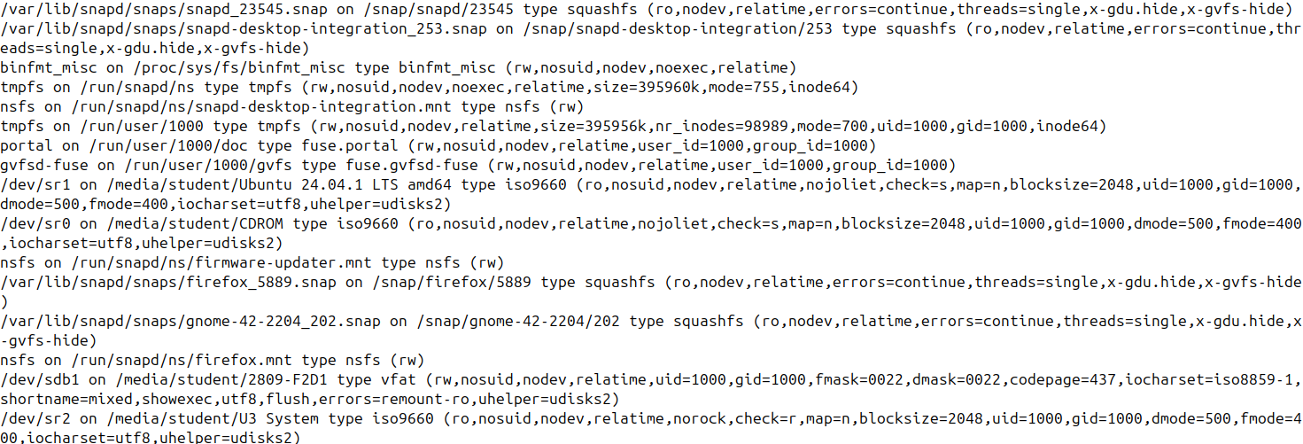
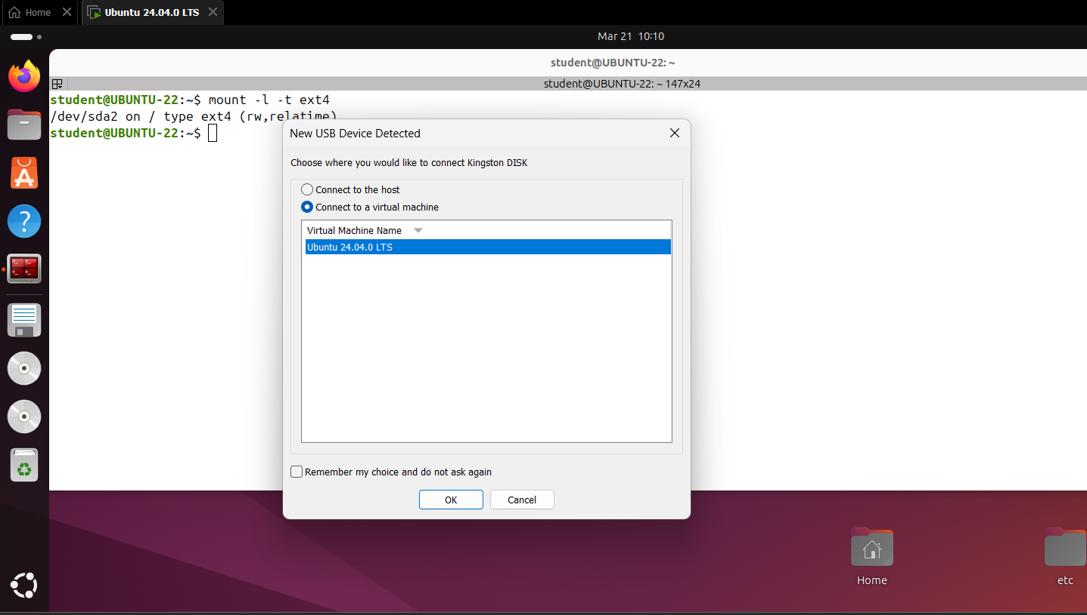
Mounting and Unmounting File Systems (df, mount, umount, fdisk, gparted)
Let's mount a new filesystem in a given location, or a mount point. I'm going to insert a USB stick!
On Ubuntu, when you insert a stick, it will be automatically mounted in /media, the user name of the user who's logged in, and another directory with the name of the USB stick

Slide 18
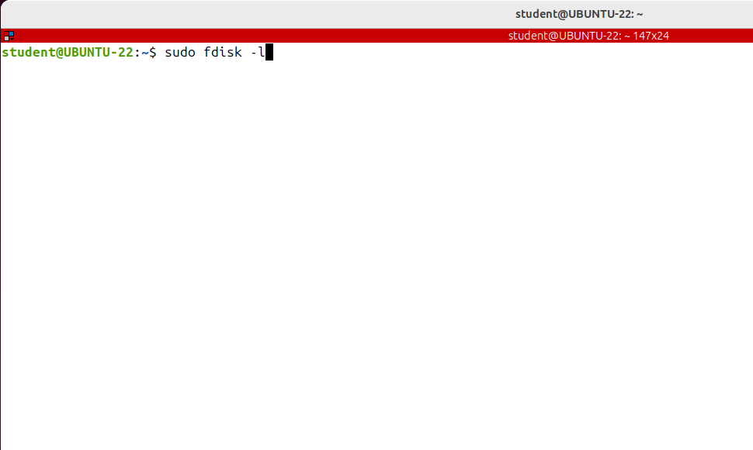
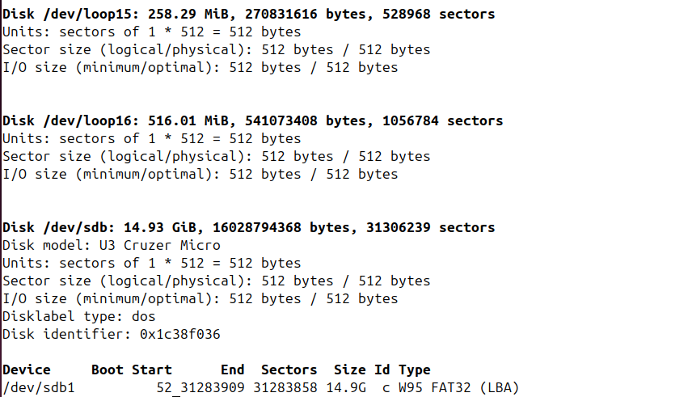
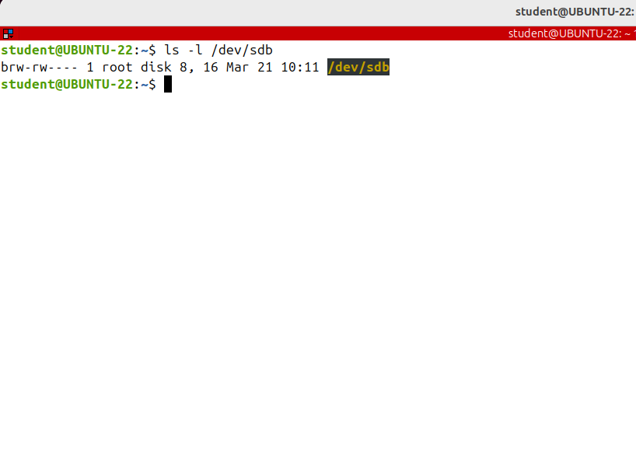
Mounting and Unmounting File Systems (df, mount, umount, fdisk, gparted)
Sometimes it's not mounted automatically, like in the case of a disk partition, or you want to mount it in another place or with other options. In Linux, a storage device is logically represented as a special char device file in /dev. In this example, it's sdb.
This is a char device file that represents the USB stick.
To find the name of the device file you run as root fdisk -l
This is the file.

Slide 19
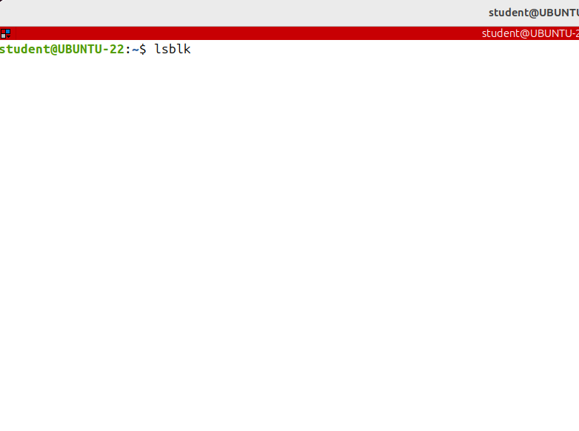
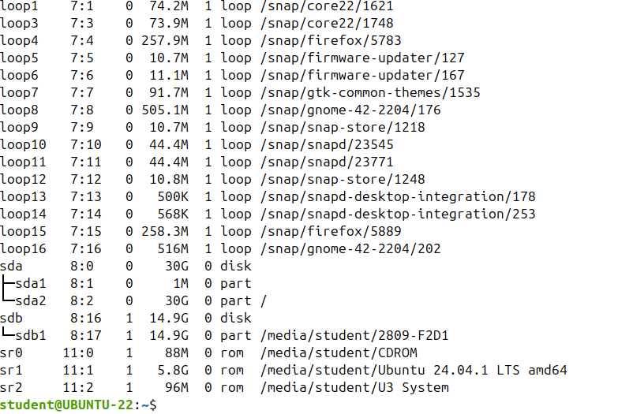
Mounting and Unmounting File Systems (df, mount, umount, fdisk, gparted)
To find the name of the device file you can use lsblk command

Slide 20
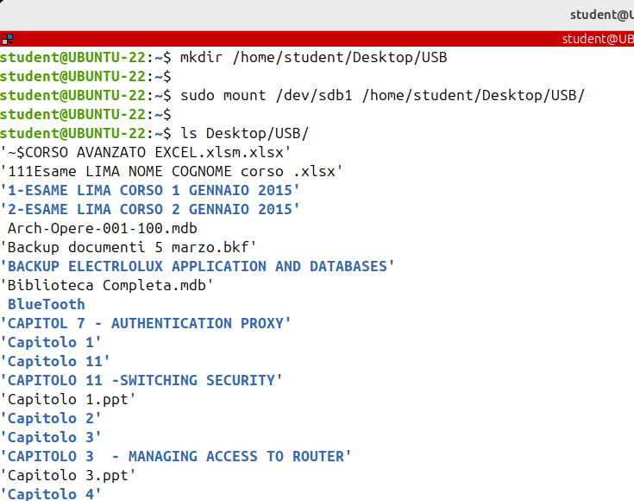
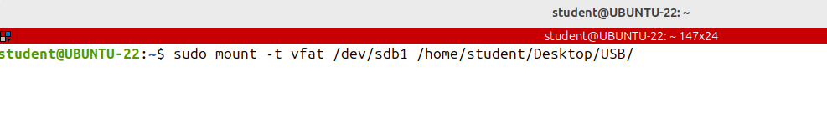
Mounting and Unmounting File Systems (df, mount, umount, fdisk, gparted)
Having the name of the device file we can mount it in any directory that already exists.
I'm creating a new directory on the desktop
mkdir /home/student/Desktop/USB.
This is the directory and I'm running the mount command.
Note that only root can mount partitions using the mount command
Note that you can mount the same physical device in different places; in this example, the USB stick is mounted on both /media and on the desktop.
It's mounted on two different directories.
The mount command will auto-detect the filesystem type. However, some filesystems are not automatically recognized and the need to be explicitly specified. Use the -t option to specify the filesystem
type, like this:

Slide 21


Mounting and Unmounting File Systems (df, mount, umount, fdisk, gparted)
When you want to unmount a disc or a partition, run the umount command and the mount point.
You are allowed to unmount partitions only if they are not used; so close any open files
or directories on that partition.
Alternatively, you could try a lazy unmount using the –l or --- lazy option.
It will unmount a busy file system as soon as it's not busy anymore.
If you realized that by mistake you have mounted it read only you can remount it with other options like this:
If you want to specify other additional options, use the -o option. Let doing an example….

Slide 22

Mounting and Unmounting File Systems (df, mount, umount, fdisk, gparted)
Let's see how to mount an iso file.
Many downloadable operating systems, including Windows and various Linux distributions, are distributed as ISO images.
To mount such an image start by creating the mount point at any location you
Want for example mkdir ~/iso Then mount the image using the mount command and
the - o loop option, like this:

Slide 23


Mounting and Unmounting File Systems (df, mount, umount, fdisk, gparted)
I want to give you some tips about disk partitioning. You can always use the fdisk command, which is the standard utility used to manage disks and partitions.
However, at least for beginners, this is not the easiest task. You can get in lots of troubles and the risk of losing data is huge.
My advice is to make a backup of the most important files before working with disks and partitions.
And if you run a graphical interface, use a program called gparted instead. Gparted is a free partition editor graphically managing your disk partitions.

Slide 24




Service Management (systemctl)
I want to know how to manage services using systemctl.
This is a very common sysadmin job.
First, using apt, I’ll install nginx, a well-known web server : I'll execute the many commands as root so I'll become temporarily root in this terminal by running sudo su.
To find the nginx service status run: systemctl status nginx.service

Slide 25



Service Management (systemctl)
To stop the service run systemctl stop ngnix.
Now it's inactive or dead. Let's refresh the webpage.
It's not working anymore

Slide 26


Service Management (systemctl)
To restart a running service you can use the restart command.
if you are unsure whether the service
has the functionality to reload its configuration without restarting, you can issue the reload or restart
This is very important since on Linux the configuration of a server is read only when the server starts.
This means that if you change anything, you need to restart the server so that the new config comes into effect.
If the application is able to reload its configuration files without restarting, you can issue the reload command.
This will reload the configuration in place, if possible. Otherwise it will restart the service so that the new configuration is read.

Slide 27

Service Management (systemctl)
To configure a service, to start at boot time, use the enable command.
Keep in mind that enabling a service does not mean that it starts now, in the current session.
The start, stop and restart commands refer to the current session, what's happening to the service now and the enable and disable commands refer to what will happen at boot time. For example I can stop nginx now, but configure it to start automatically next time the system boots up
To check if a service will start automatically at boot time use the is-enabled command.
To disable the service from starting automatically use the disable command.

Slide 28



Service Management (systemctl)
To prevent the service from being started automatically or manually, use the mask command

Slide 29

Service Management (systemctl)
To unmask a unit, making it available again for use, simply utilize the unmask command: systemctl unmask nginx and systemsctl start nginx.

Slide 30


Service Management (systemctl)
To see a list of all of the active units the systemd knows about, use the list-units command

Slide 31

COMMANDS (systemctl)

Slide 32





QUIZ TIME

